Slide 1
Introduction

Slide 2
Objectives
Define computer security as well as basic computer security terms
Introduce the C-I-A Triad
Introduce basic access control terminology
Explain basic threats, vulnerabilities, and attacks
Show how controls map to threats

Slide 3
What Is Computer Security?
The protection of the assets of a computer system
Hardware
Software
Data

Slide 4
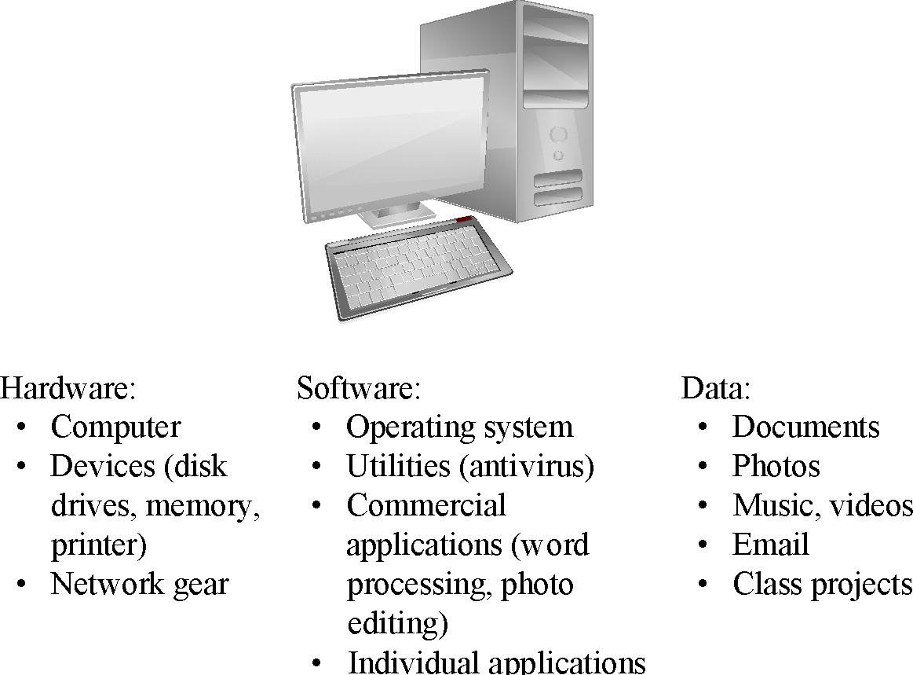
Assets

Slide 5
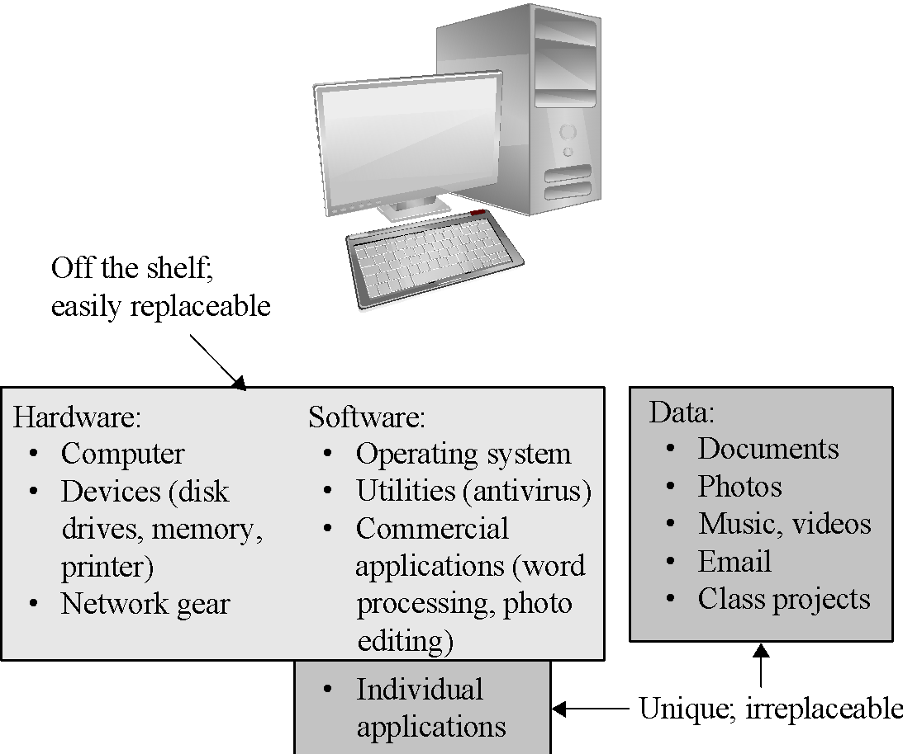
Values of Assets
Notes:
While hardware and software may be expensive, unique data cannot be replaced if it is lost.

Slide 6
Basic Terms
Vulnerability
Threat
Attack
Countermeasure or control
Notes:
There will be further discussion of each later in the chapter.

Slide 7
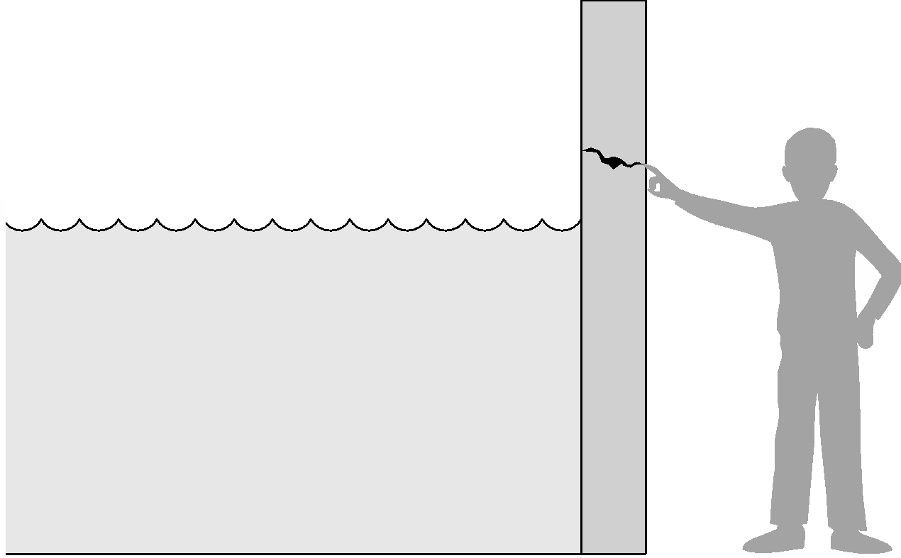
Threat and Vulnerability
Notes:
The water is the threat, the crack the vulnerability, and the finger the control (for now).

Slide 8
C-I-A Triad
Confidentiality
Integrity
Availability
Sometimes two other desirable characteristics:
Authentication
Nonrepudiation

Slide 9
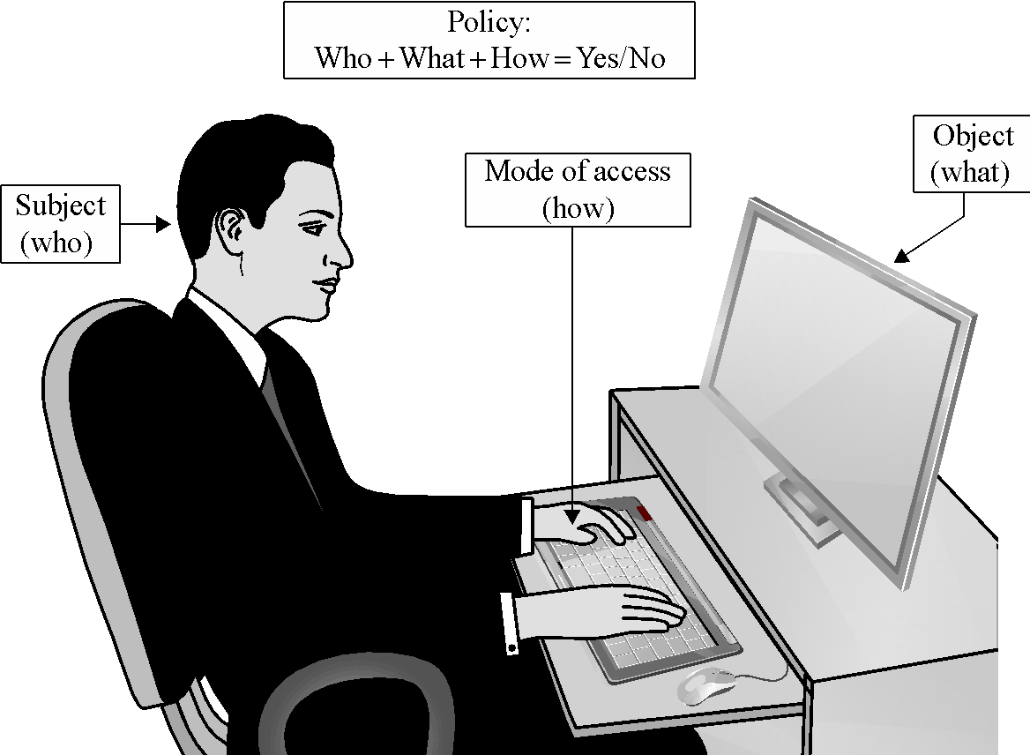
Access Control
Notes:
Visual explanation of basic access control terms

Slide 10
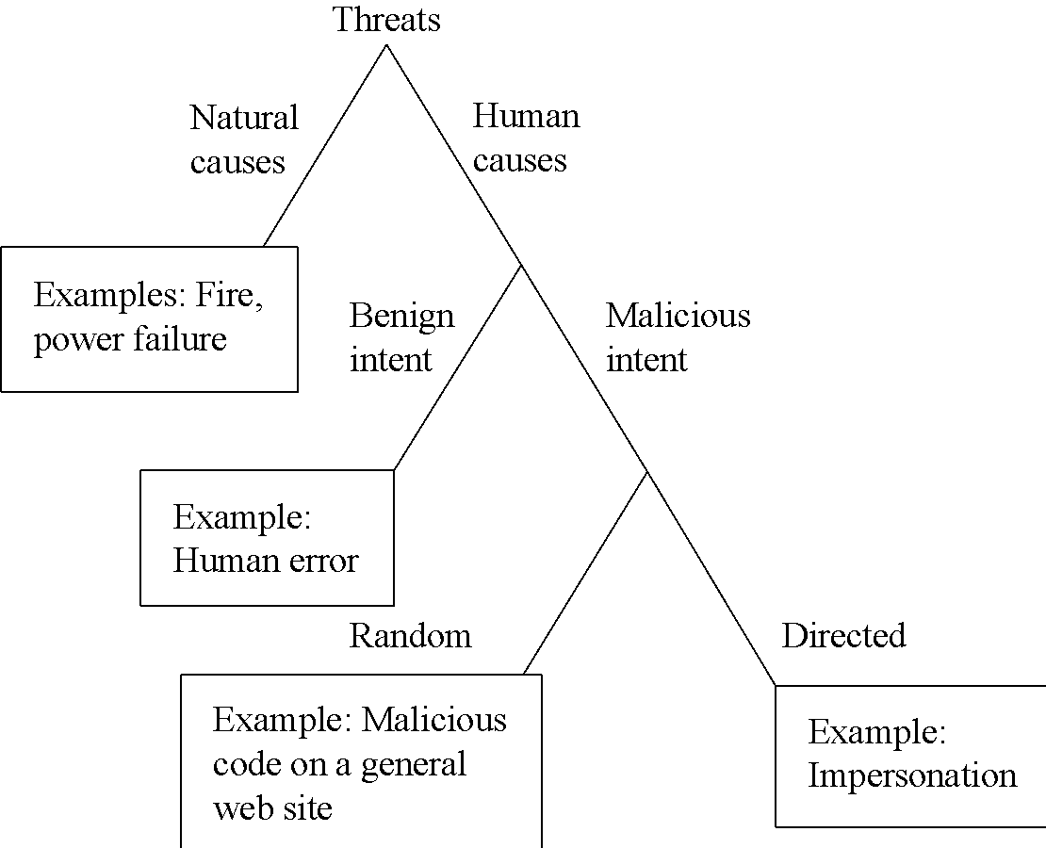
Types of Threats
Notes:
This diagram shows threats categorized according to whether they are human-caused, malicious, or directed. These characteristics will affect security planning in important ways later.

Slide 11
Advanced Persistent Threat (APT)
Organized
Directed
Well financed
Patient
Silent
Notes:
APT is a special type of threat that has only been taken seriously by the broad security community over the past decade. In general, security experts believe that no one who becomes a high-priority target can truly be safe from APT.

Slide 12
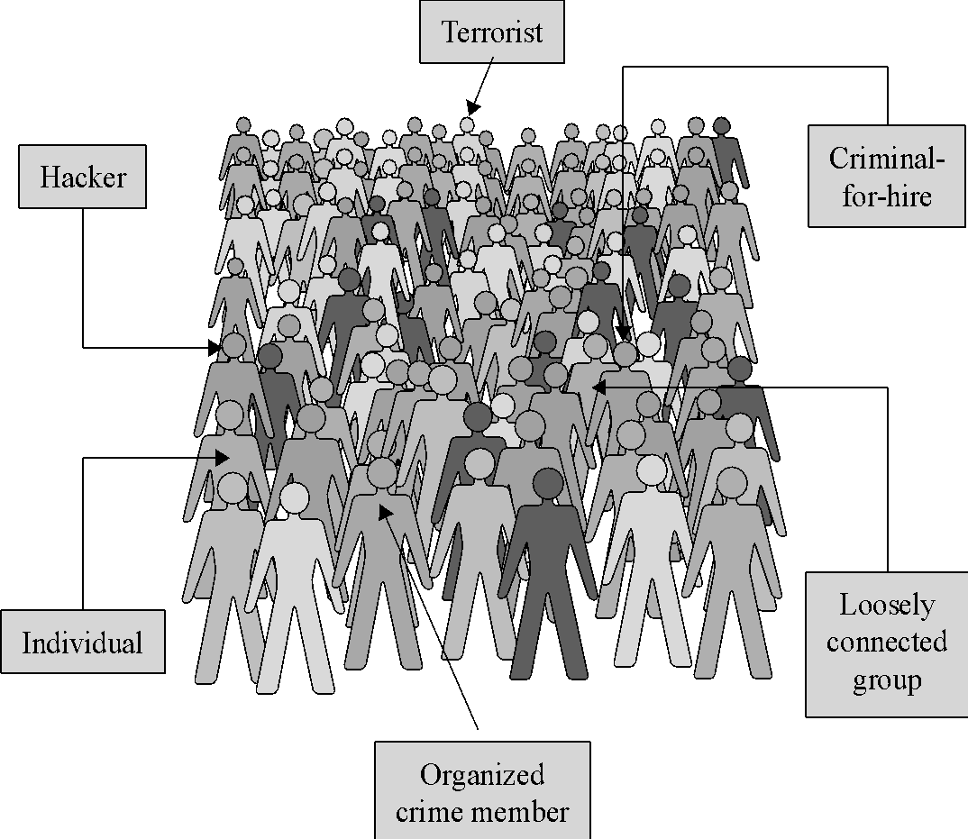
Types of Attackers
Notes:
Each of these attacker types is associated with a different set of resources, capabilities, and motivations. Understanding the different types will help later in considering threats.

Slide 13
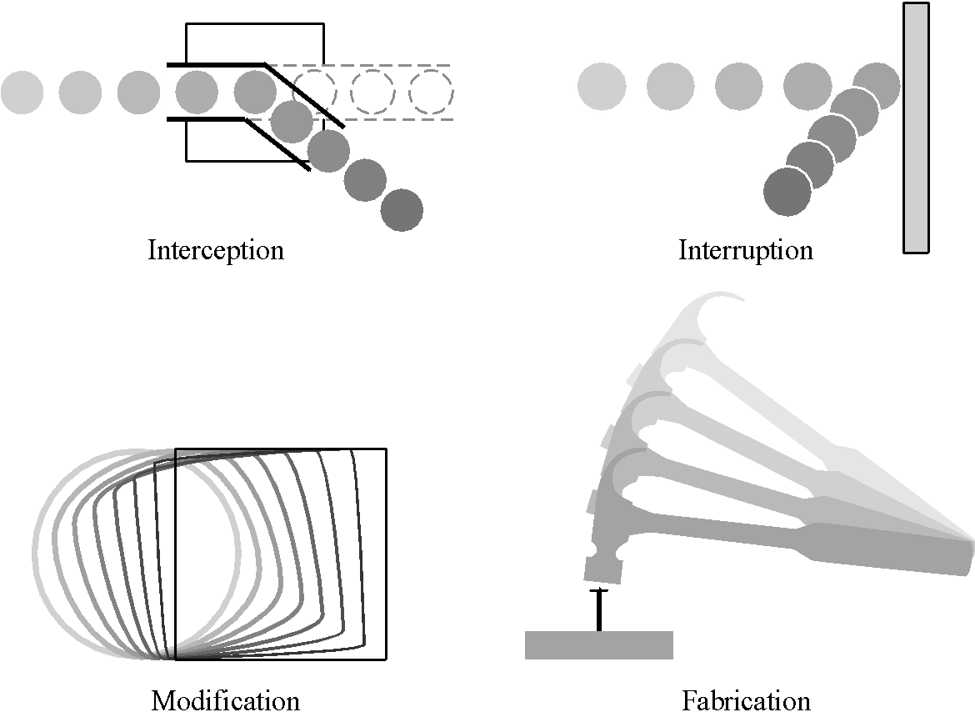
Types of Harm
Notes:
These are the primary types of harm against system data and functions. Understanding these possibilities is important to considering threat and risk.

Slide 14
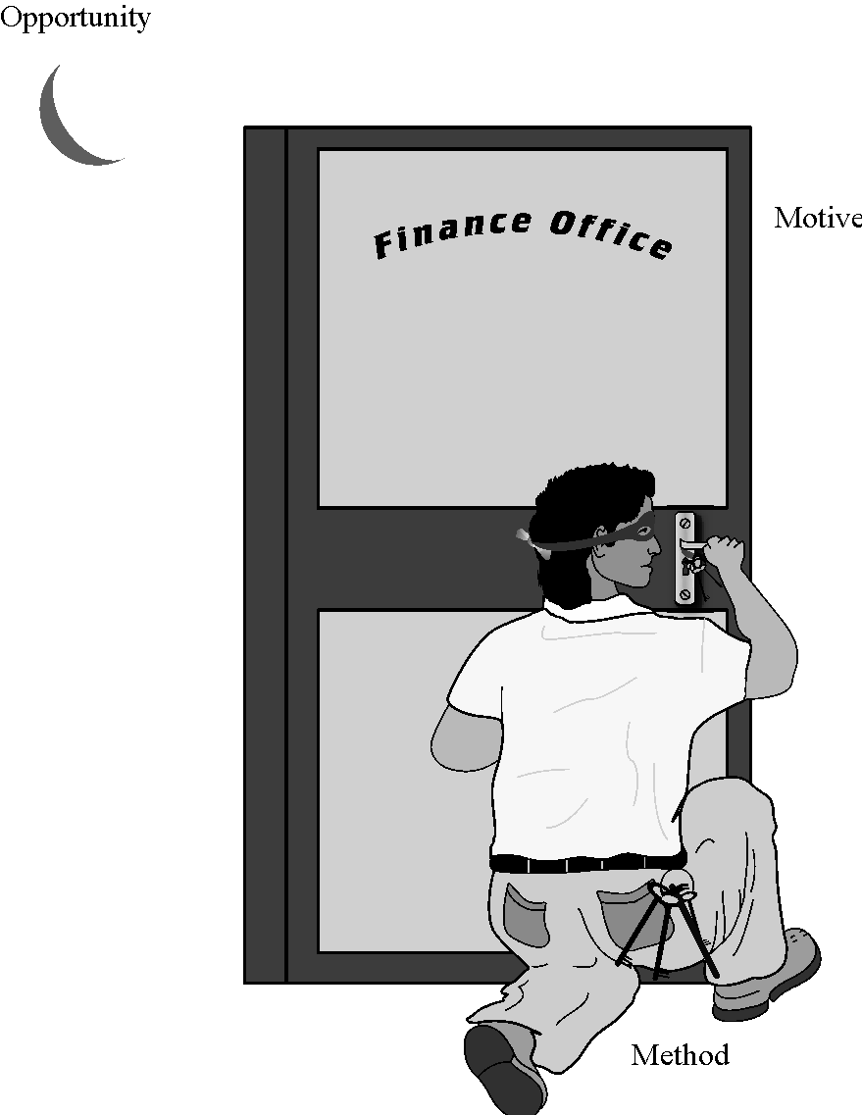
Method—Opportunity--Motive
Notes:
Understanding method, motive, and opportunity can be a good way to think about potential threats. Reducing any of those dimensions can lower the risk to the system.

Slide 15
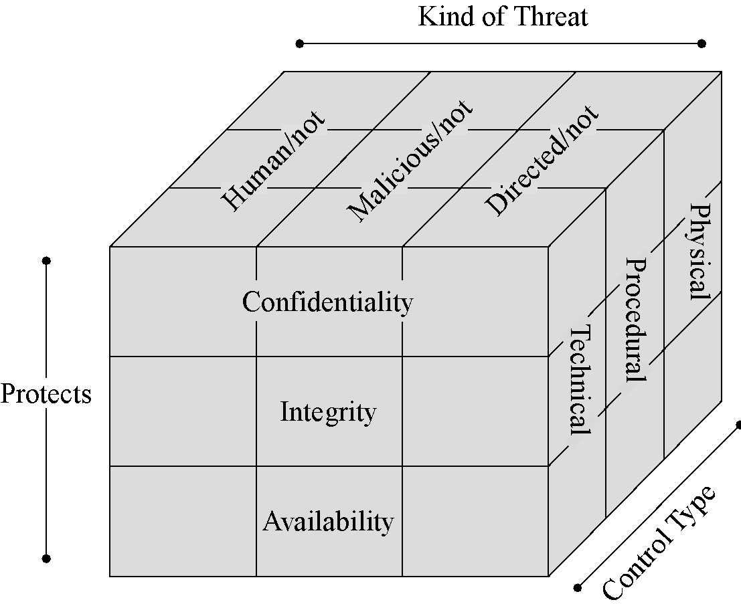
Controls/Countermeasures
Notes:
This representation shows the three dimensions by which a control can be categorized. Thinking about controls in this way enables you to easily map the controls against the threats they help address.

Slide 16
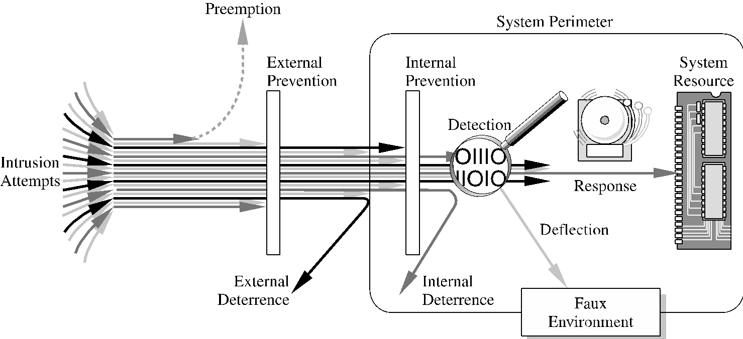
Different Types of Controls
Notes:
In this simple representation of a networked system, it is easy to see all the touch points where controls can be placed, as well as some different types of controls, including deterrence, deflection, response, prevention, and preemption.

Slide 17
Summary
Vulnerabilities are weaknesses in a system; threats exploit those weaknesses; controls protect those weaknesses from exploitation
Confidentiality, integrity, and availability are the three basic security primitives
Different attackers pose different kinds of threats based on their capabilities and motivations
Different controls address different threats; controls come in many flavors and can exist at various points in the system

